Slide 1
20.2 File Processing and Exception Handling
Write code to perform file-processing operations
Show understanding of an exception and the importance of exception handling
Open (in read, write, append mode) and close a file Read a record from a file and write a record to a file
Perform file-processing operations on serial, sequential, random files
Know when it is appropriate to use exception handling Write program code to use exception handling

Slide 2
Today
Write code to perform file-processing operations
3. Open (in read, write, append mode) and close a file Read a record from a file and write a record to a file
4. Perform file-processing operations on serial, sequential, random files
Understand: What are different ways to store records
Able: Read, write and append to a file
Answer: What’s the difference between serial and sequential files?

Slide 3
What are similarities between the following:
JPEG
GIF
MP4
DOCX
PPTX
PNG
MOV
They are all file extensions
They tell the computer what program to use to open that file. PPTX opens in PowerPoint for example
They all store data in binary
When you want to store data that is to be used by a computer program, there are only two types of files you can use:
Text file
Binary file

Slide 4
Text Files vs Binary Files
Text files contain data that is stored using a specific character codes – examples ASCII
You can make your own text file by using a text editor – like notepad
A binary file stores data using its own internal representation. For example an integer may be stored using four bytes (32 bits)
A binary file will be made using a specific program
A binary file uses records
The binary file is a collection of records.
A record can have many fields
A field can have a value

Slide 5
Serial, Sequential, Direct Access files
Binary files also have different ways of storing their and accessing data
Serial
Sequential
Direct Access

Slide 6
Serial
You start with an empty file
You add data to it
You add more data to it and get goes on the end. Its appended to the end
Data is stored in the order it arrived
But there is no other order to the data
29
983
12
316
638

Slide 7
Serial
If you want to delete data. Example 983
All the data, apart from what you want deleted gets copied and given a temporary name.
There is now a gap in the file
Then you have to rename the temporary file
Batman
29
983
12
316
638
Temp
Batman
29
12
316
638

Slide 8
Serial
Is a text file serial?
Look at this example. How do you know when one line stop and another starts?
I have an apple. I have a pen. Ehh Apple Pen. I have a pineapple. I have a pen. Ehh Pineapple Pen. Pen Pineapple Apple Pen.
It uses full stops / periods “.”
It uses end of lines characters
A binary file needs an end of record character so you know when one record ends and another starts

Slide 9
Serial
For large files is bad because you have to copy into a temporary file and rename
No order means to find anything you must start from the beginning and go 1-by-1 (linear search)
Used for transactions in shops and banks.
Whenever you spend money on Taobao using Alipay then your record updates itself and says the day and time you bought stuff but the rest of the information is not in any order. The data arrived in the order of when it came.

Slide 10
Sequential Files
Records are in order
Uses a key field to put things in order
Is a key field for a binary sequential file the same as a primary key in a database?
Look at the database. It has a primary key.
Is the primary key valid?
Is the primary key in order?
And that’s the difference between a key field and primary key. A key field for sequential files must be unique AND in correct order.
ID | NAME
1 | BATMAN
3 | SPIDERMAN
2 | WONDER WOMAN
4 | HULK
5 | THOR

Slide 11
Sequential Files
Is this a valid key field?
Are they unique?
Are they in order?
Then its okay. That’s all we care about, unique and order. It doesn’t matter if they are consecutive as long as they are in order
ID | NAME
1 | BATMAN
3 | SPIDERMAN
5 | WONDER WOMAN
7 | HULK
8 | THOR

Slide 12
How does it work
Lets say you want to add Superman and he has a key of 6.
1: You current data is copied to a temp file one by one
2: When it reaches the correct position your data is inserted
3: The remaining data is filled in
4: The temp file is renamed
ID | NAME
1 | BATMAN
3 | SPIDERMAN
5 | WONDER WOMAN
7 | HULK
8 | THOR
ID | NAME
1 | BATMAN
3 | SPIDERMAN
5 | WONDER WOMAN
6 | SUPERMAN
7 | HULK
8 | THOR
ID | NAME
1 | BATMAN
3 | SPIDERMAN
5 | WONDER WOMAN
6 | SUPERMAN
7 | HULK
8 | THOR

Slide 13
Searching
Because the data is in order, it is easier to stop searching.
With serial, you start at the start of your data and go all the way until the end, one-by-one and you hope the thing you want is there. (The thing you want is called the key….not to be confused with sequential key field)
With sequential, you start at the start of your data and go though one-by-one. But if you are searching for ”4: Captain America”.
You start at 1: Batman, then 3: Spiderman, you know that if 4: Captain America should be next but you
find 5: Wonder Woman…you know your data is not there, so you just stop searching
This is much quicker than serial and you are ONLY searching for the Key, in this example we only are looking for 4 not 4 Captain America
ID | NAME
1 | BATMAN
3 | SPIDERMAN
5 | WONDER WOMAN
6 | SUPERMAN
7 | HULK
8 | THOR

Slide 14
Sequential
If sequential means you must sort your data by the key field, what's the best way to make sure your file is sequential
Two methods to make sure your data is sequential
1: You add data and as soon as you add data you sort everything to make sure its order
2: You add data and for a while its just like a serial file, but then at certain points (every 8 hours, every week, once a month) you sort your data
The method you use to sort data can be different depending on what's best for you. Bubble sort, insertion sort, quicksort….
An example of where you would use sequential is an address book / contact lists. You want the data in order but not in the order they were added but by order of name

Slide 15
Sequential problem
Our example is a simple one. Our record just happens to two fields (ID and Name)But lets say you have a simple database that has student ID, First Name, Last Name and Age. 4 fields for one record
When you search though this, if you want the third record (yellow), you are having to go though 8 separate fields.
And what if you wanted to change your database to include Telephone number, now you want each record to have 5 fields and now you must redo your entire database
ID | NAME
1 | BATMAN
3 | SPIDERMAN
5 | WONDER WOMAN
6 | SUPERMAN
7 | HULK
8 | THOR
ID | First | Last | Age | ID | First | Last | Age | ID | First | Last | Age | ID | First | Last | Age
1 | Jack | Bauer | 40 | 2 | David | Palmer | 50 | 3 | Walter | White | 56 | 4 | Ayra | Stark | 14

Slide 16
Direct Access
Direct Access is also called Random Access.
It lets you jump to where you want to go, but how?
The first thing you need is to know your record structure:
We had ID, First Name, Last Name and Age
Lets say ID will take 2 bytes
First Name will be maximum 50 letters so in ASCII that’s 50 bytes
Last Name will be 100 letters, so that’s 100 bytes
Age will be 3 bytes (maybe someone is aged 100 or more)
2 + 50 + 100 + 3 = 155 bytes
So we know one record is 155 bytes

Slide 17
Direct Access Bytes
Remember one record is 155 bytes.
The first record will start at position 0,
The second record will start at 155
The third record will start at 310
The fourth record will start at 465
So now, if you want the third record you can just jump to position 310
Why start at 155 and not 156? Because we begin from 0
Address of nth record = Address at beginning + ((n-1) * record size)
Location you want = 0 + ((n -1) * 155)
Or (n-1) * record size

Slide 18
Problems
Wastes space.
For example my structure allows for a first name to be 50 bytes and last name 100 bytes. That’s 150 bytes. But my first name, “Jack” and my last name “Bauer” only has 9 bytes in total. The other 141 bytes are filled with empty space
You can avoid this problem by using a different method. CSV – Comma Separated Value.
This type of file uses a comma to separate different fields, the length doesn't matter because the computer just looks for the comma
1, Jack, Bauer, 40, 2, David, Palmer, 50, 3, Walter, White, 56, 4, Ayra, Stark, 14
In a CSV file you should use a comma, but in real life it can be anything. A comma, a full stop, a space, a hyphen - , colon: all of these special characters used to identify where a field ends is called a delimiter

Slide 19
Delete data
If you want to delete data from a direct access file you can do so.
There is no need to copy to a temp file and rename like in Serial or sequential, all that happens in direct is a marker or flag is placed where the deleted record is and the computer just skips this

Slide 20
Record Key
Our example makes it sound like that the records must be next to each other, but in reality our records can be anywhere they like within the file.
So, how would you know where a record is or where you should put a record?
There is a relationship between the key of that record and where the record is located.
The value of the record key is mapped to an address where the record is. A mapping function is used to calculate where a record should be based on the record key
The advantage of this is that you do not need to search though the whole file to find a record but you just use the mapping function and jump to where you want. The time it takes to find a record is the same for every record regardless of where it is in the file.

Slide 21
Hashing
So we need a mapping function to say, based on the record key, where our record is.
But what is the mapping function?
You could have it say whatever the record value is then that’s its place in the file.
You could have a lookup table
But Cambridge and the most common form is to have a hashing function

Slide 22
Hashing
Hashing is where you take the key value, apply some maths to it and then it says what address you should use.
Simple example is if my hash was: (Key + 888) / 4
So if my record key was 12 (12 + 888) / 4
Equals 225. And that’s where my record will be placed in the file.
Cambridge example is to say take the record key, divide it by a large number and then use the remainder as your position.
There maybe times where you will get the same answer after your hash function.
This is called a collision
In this case the nearest next position is used. If this does happen, when you search for a record you can jump to where you think it should be and do a quick serial search for your data.
Because of collisions you should make sure your hash function is: Quick to calculate Cover the range of addresses you have Spread out the distribution Ensure it does not give a cluster of locations in one area

Slide 23
Little issue
Now we have used a website to do Python
So we cannot do this as perfect as I want.
I want us to use a text file that’s stored on our computer.
But we cannot do this with the website, the website will actually fake a text file for us.

Slide 24
Create / Open a file
I’m going to make a new file called Batman.txt
file = open(”Batman.txt","w")
file.close()
file is actually our variable name. You can call this whatever you like
open means you want to open a file
Batman.txt is the name of the file you want
w stands for Write mode.
You can also have:
a stands for append mode, this adds data to the end of a file
r+ stands for a special read and write mode
You also have:
r stands for Read mode, but if you don’t type a letter then Python automatically thinks its read mode, so you don’t really need to use r
Now this code opens a file, but because we are using the online Python, it also create this for us too.

Slide 25
Write to a file
To write something, first we open a file, then we use file.write
file = open("Batman.txt","w")
file.write("Hello Students")
file.write("You are so lucky")
file.write("to have Amar in your life")
file.write("You're welcome!")

Slide 26
New Line
That code will write everything on one line. But what if you want a new line?
Use (“\n”)
file = open("Batman.txt","w")
file.write("Hello Students")
file.write("\n")
file.write("You are so lucky")
file.write("\n")
file.write("to have Amar in your life")
file.write("\n")
file.write("You're welcome!")

Slide 27
Read from a file
To read from a file you use VARIABLE NAME.read()
file = open("Batman.txt")
print (file.read())
This makes a variable called file
Which will open Batman.text
Then you just print (VARIABLE NAME.read())

Slide 28
Read specific parts
What if your file has 10000000000000000 characters but you only want to print out the first 6
file = open("Batman.txt")
print (file.read(6))

Slide 29
Task
What is the code to:
Copy a file
Move a file

Slide 30
Code
If you managed to do that last task then you are wonderful!
I say this because you really needed something extra.
The new piece of code you need is shutil.copy
But if you write shutil.copy then an error will happen
shutil stands for Shell Utilities. To use shutil.copy you need to tell Python that you really want this.
import shutil
shutil.copy("Batman.txt", "Batman22.txt")
import shutil - This will import all the shutil features. shutil.copy(ORIGINAL NAME, COPIED NAME) – This will copy the file and give it a new name

Slide 31
Moving a file / Rename a file
If you want to rename a file, it’s the same as moving a file.
You still need shutil
Import shutil
shutil.move("Batman.txt", ”Catwoman.txt")

Slide 32
Task
Create a new text file
Add 5 lines of data
Print all the data from the file
Make a copy of this file
Rename this copy
Print only the second line
Add the words “Pizza is great” between the 3rd and 4th line

Slide 33
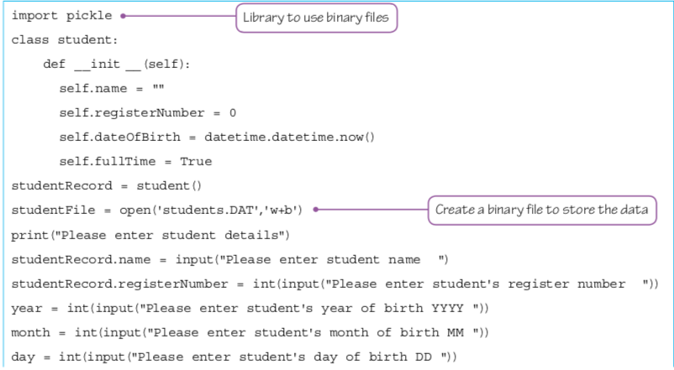
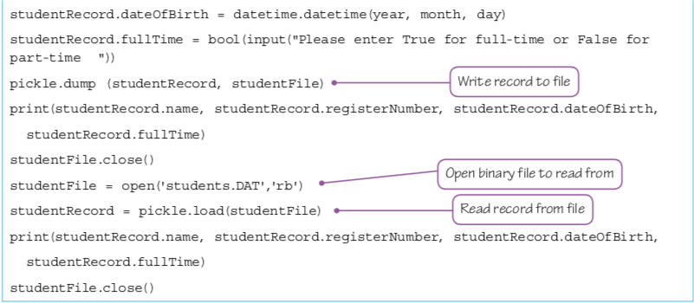
Coursebook.
Your Hodder coursebook (Page 527 and 528) has different code to write to a serial file.

Slide 34
Too easy
With a serial file, if you want to add something to the end (append), its easy, you just add it on the end.
But what if you want to add something in a sequential file?
You have remake the whole file to make sure your new record is in the correct place.
Page 531 of your Hodder book has the Pseudocode for it.
For a direct file you have to just make sure your hashing function is working

Slide 35
Some easy fun things in Python
This next stuff is how you can play around in Python.

Slide 36
String Manipulation
For all examples, we will start with:
word = “Batman is better”
Length
Finding the length of the string (we’ve done this before)
len(word)
Letter Print
Print a specific letter from a string
print (word[8])

Slide 37
word = “Batman is better”
Count a letter
Counts how many times the letter ‘t’ is there
print (word.count("t"))
Count Spaces
Count the number of spaces
print (word.count(" "))
Find a letter
Finds the position of the letter ‘i’
print (word.find("i"))

Slide 38
word = “Batman is better”
Print the first three letters
print (word[:3])
Prints the last three letters
print (word[-3:])
Print everything except the first three letters
print (word[3:])
Prints everything except the last three letters
print (word[:-3])

Slide 39
word = “Batman is better”
Finds the letter ‘a’ and splits your word in those places
print (word.split("a"))
Checks to see if your word starts with a ‘B’
print (word.startswith("B"))
Checks to see if your word ends with ‘r’
print (word.endswith(”r"))
Prints your word 10 times
print (word*10)

Slide 40
word = “Batman is better”
Word Replace
Replaces Batman with Superman
print (word.replace("Batman","Superman"))
Uppercase
Make all letters uppercase
print (word.upper())
Lowercase
Make all letters lowercase
print (word.lower())

Slide 41
word = “Batman is better”
Make the start of each word a capital letter (Title Case)
print (word.title())
Make the first letter a capital letter (Capitalize)
print (word.capitalize())
Swap the uppercase for lowercase and the lowercase for uppercase
print (word.swapcase())
Reverses the letters
print(word[::-1])

Slide 42
word = "wwwwwwwwwwBatman is betterwwwwwwwww”
To show this better, I have added some w’s
word = "wwwwwwwwwwBatman is betterwwwwwwwww”
Strip the letter ‘w’ from both ends
print (word.strip("w"))
Strip the letter ‘w’ just from the left
print (word.lstrip("w"))
Strip the letter ‘w’ just from the right
print (word.rstrip("w"))

Slide 43
Extra things
print(word.isalnum()) #check if all char are alphanumeric
print(word.isalpha()) #check if all char in the string are alphabetic
print(word.isdigit()) #test if string contains digits
print(word.istitle()) #test if string contains title words
print(word.isupper()) #test if string contains upper case
print(word.islower()) #test if string contains lower case
print(word.isspace()) #test if string contains spaces
print(word.endswith("d")) #test if string ends with a d
print(word.startswith("H")) #test if string starts with H

Slide 44
Task
Make a program that lists all of the string manipulation procedures in a menu
The user can then type in any word(s) they want
Then they select the string procedure they want
Then your program outputs the result

Slide 45
Today
2. Show understanding of an exception and the importance of exception handling
5. Know when it is appropriate to use exception handling Write program code to use exception handling
Understand: What is an exception
Able: Write expection handling code
Answer: What are the different types of exceptions?

Slide 46
Exception handling
This is when an error occurs when you run your code.
So far, when your program runs, if there is a mistake your program just stops and says it cannot continue.
This section will deal with the types of errors and how to handle them
There are three main types of errors
Logic Errors
Syntax Errors
Run time errors
(Python actually has more – we will also do these)

Slide 47
Logic Errors
Usually when a human makes a mistake
Its when the code works but the result is not what you wanted.
Example: You want to multiply a number by 5
Your code is:
A = A * 55
Console.WriteLine(A)
This code works, but you will not get the result you want because you have a logic error of trying 55 instead of 5

Slide 48
Syntax Error
This is when you do not follow the rules of the programming language you are using.
Example:
To make a new variable you should write:
Dim A As Integer
This is correct
But if you type:
Dim As A Integer
This will be a syntax error because you should have ‘A’ before ‘As’ but you did not. You made a mistake – you have a syntax error.
You could also have:
Din A As Integer (This is a spelling syntax error – Dim not Din)
Dim A (This line is incomplete because you did not say any data type)

Slide 49
Run time errors
When you try to divide by 0
Trying to go to array index 11 when your array size is only 5
Trying to open a file that does not exist.
Your logic may be correct.
Your syntax may be perfect
But its still an error. It is a run time error
A run time error is also called an exception
And instead of having your program just crash and tell you an error message for you to fix. You can have another piece of code to handle (resolve) the exception
This piece of code is called an exception handler

Slide 50
More Exceptions
Python also has: IOErrors : Input Output errors. Example you cannot open a file
ImportError: Python cannot find the module or collection you want
ValueError: You get an inappropriate value. Example a string when you wanted int
KeyboardInterrupt: If you press Ctrl+C or Ctrl+Del to stop your code
EOFError: An end of file error. Either the EOF is needed to it came too early
ZeroDivisionError: When you try to divide by 0

Slide 51
Exception Handler
PSEUDOCODE
TRY <statementA>
EXCEPT
<statementB>
ENDTRY
If an error happens in <statement A> then its caught and handled by <statementB>. You can have multiple EXCEPT’s for each type of error
You could also include:
FINALLY
<statementX>
This FINALLY block will run if there is an exception or not.

Slide 52
Python code
a = input ("type in a number") #asks for a number. Gives it to variable a
try:
b = int(a) #takes a, converts to integer, gives it to b
print (b) #prints b
except:
print ("I asked for a number") #the message shown if you type a letter

Slide 53
Try, Except, Finally
You can have try, except and finally
try lets you test a block of code for errors.
except lets you handle the error. You can have many excepts
finally lets you execute code, regardless of the result of the try and except.

Slide 54
Task
Make a program where a user must type in a number
If that number is divisible by 3 then your program says “it can be divided by 3”
If that program is not divisible by 3 then your program says “it cannot be divided”
And no matter what number they type a message saying “thank you for typing your number” is shown
If a number is not typed in, then your program says “sorry you did not type a number, try again” and your program loops

